Slide 1
MPOPF Simulation and OpenDSS Validation
Aryan Ritwajeet Jha
Graduate Research Assistant
Washington State University
Notes:
Remember to hit the reset button to make sure all the page elements react properly.
There are 20 different layouts that you can choose from.

Slide 2
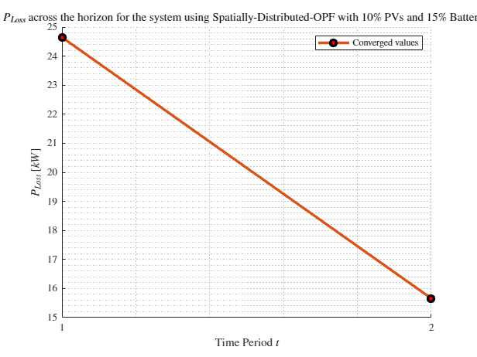
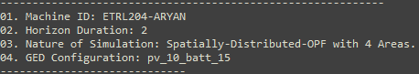
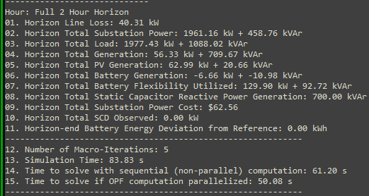
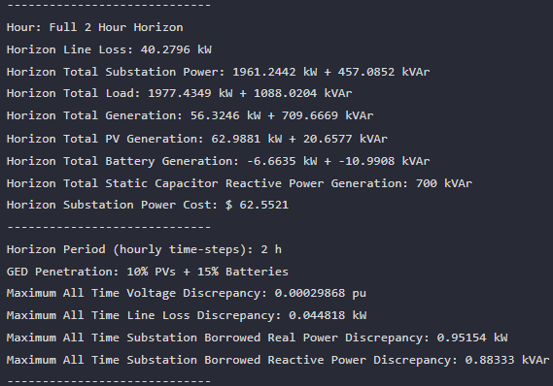

MPDOPF Verified for $T=2, PV=10\%, Batt=15\%$
strLoadShape = 'New Loadshape.LoadShape npts =2 interval = 1 mult = [1 0.7]'
strLoadShapePV = 'New Loadshape.LoadShapePV npts =2 interval = 1 mult = [1.4 0.8]'
MPDOPF Simulation Results
Alternative Profiles
OpenDSS Powerflow Results

Slide 3
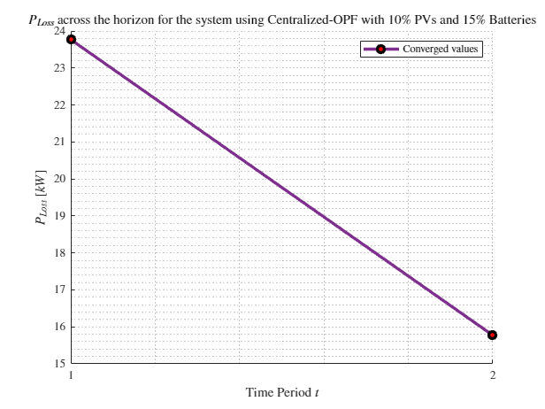
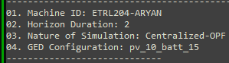
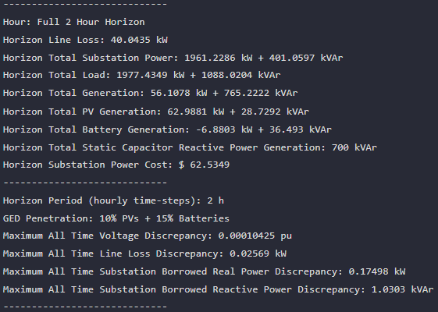
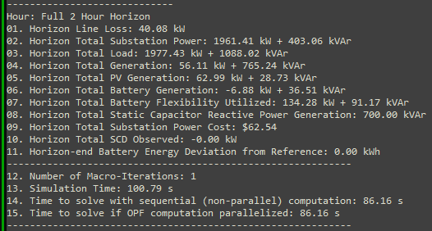

MPCOPF Verified for $T=2, PV=10\%, Batt=15\%$
strLoadShape = 'New Loadshape.LoadShape npts =2 interval = 1 mult = [1 0.7]'
strLoadShapePV = 'New Loadshape.LoadShapePV npts =2 interval = 1 mult = [1.4 0.8]'
MPCOPF Simulation Results
Alternative Profiles
OpenDSS Powerflow Results

Slide 4
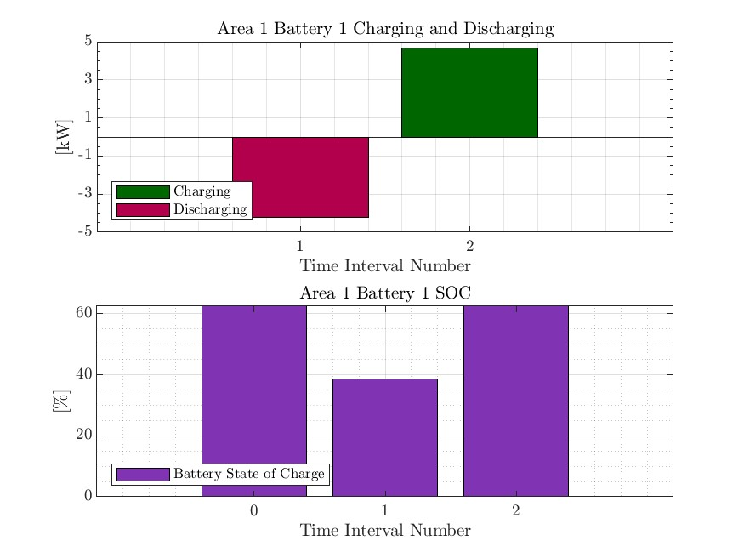
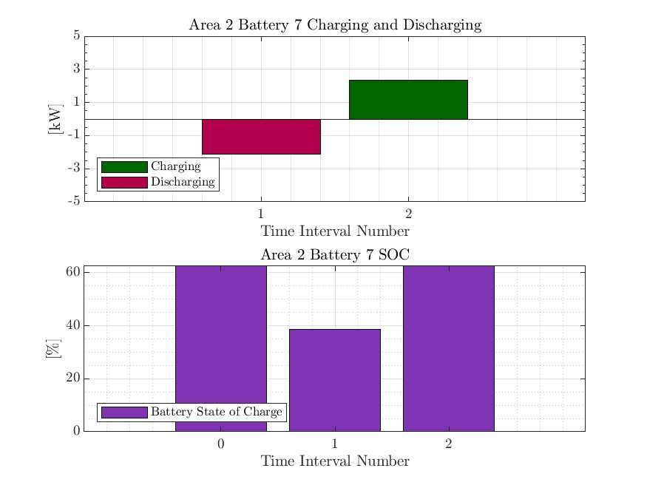



MPDOPF Verified for $T=2, PV=10\%, Batt=15\%$
strLoadShape = 'New Loadshape.LoadShape npts =2 interval = 1 mult = [1 0.7]'
strLoadShapePV = 'New Loadshape.LoadShapePV npts =2 interval = 1 mult = [1.4 0.8]'
Alternative Profiles

Slide 5




MPCOPF Verified for $T=2, PV=10\%, Batt=15\%$
strLoadShape = 'New Loadshape.LoadShape npts =2 interval = 1 mult = [1 0.7]'
strLoadShapePV = 'New Loadshape.LoadShapePV npts =2 interval = 1 mult = [1.4 0.8]'
Alternative Profiles

Slide 6
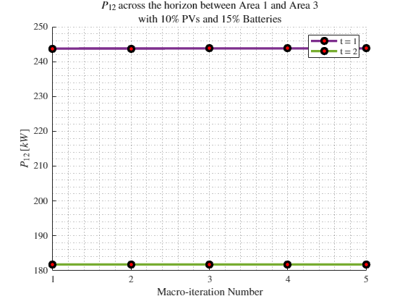
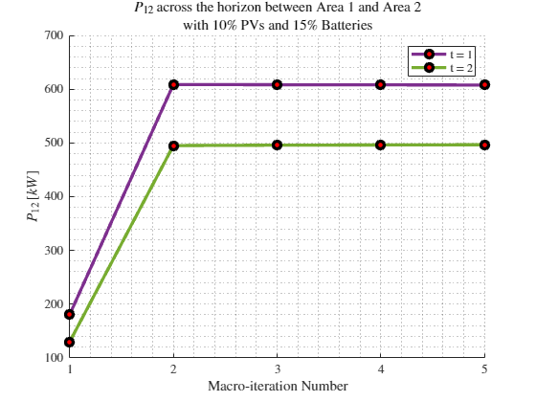
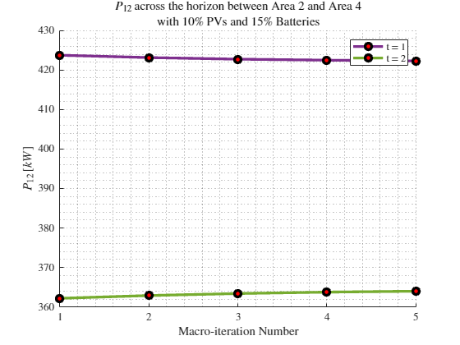

Boundary Complex Powers
strLoadShape = 'New Loadshape.LoadShape npts =2 interval = 1 mult = [1 0.7]'
MPDOPF Verified for $T=2, PV=10\%, Batt=15\%$
strLoadShapePV = 'New Loadshape.LoadShapePV npts =2 interval = 1 mult = [1.4 0.8]'
Alternative Profiles

Slide 7
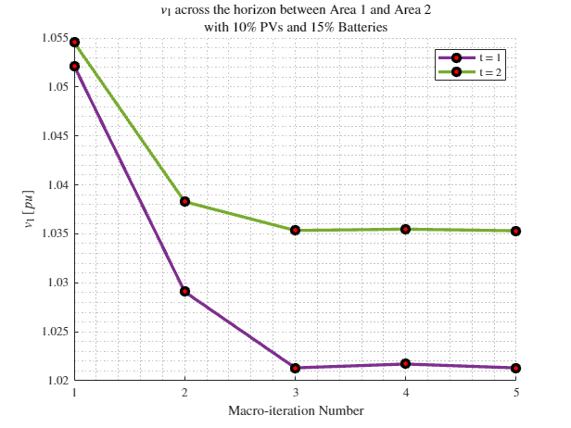
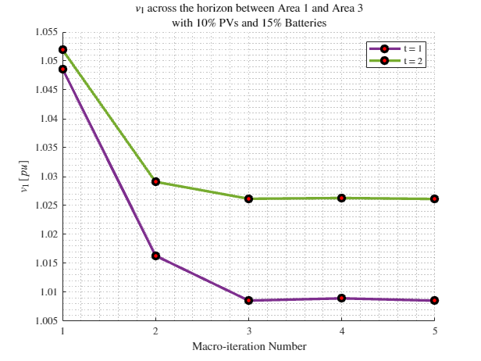
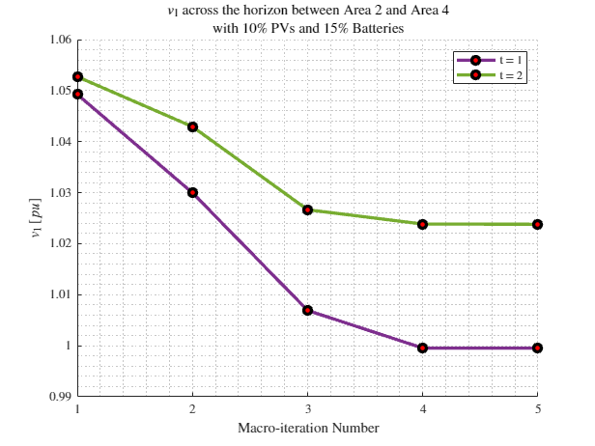
Boundary Voltages
strLoadShape = 'New Loadshape.LoadShape npts =2 interval = 1 mult = [1 0.7]'
MPDOPF Verified for $T=2, PV=10\%, Batt=15\%$
strLoadShapePV = 'New Loadshape.LoadShapePV npts =2 interval = 1 mult = [1.4 0.8]'
Alternative Profiles

Slide 8
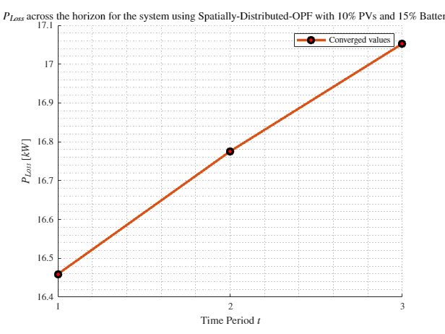
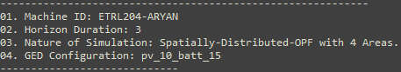
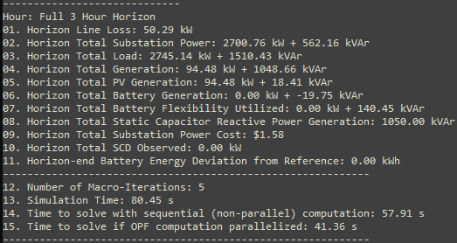
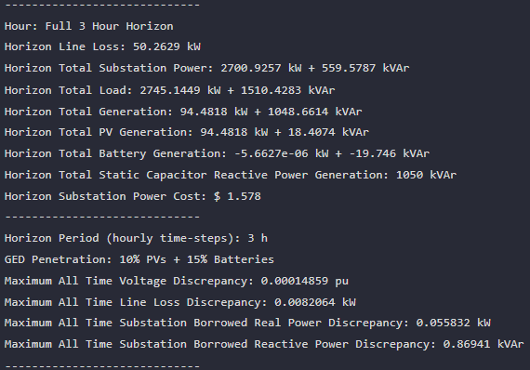

MPDOPF Verified for $T=3, PV=10\%, Batt=15\%$
strLoadShape = 'New Loadshape.LoadShape npts =3 interval = 1 mult = [0.777 0.787 0.796]'
strLoadShapePV = 'New Loadshape.LoadShapePV npts =3 interval = 1 mult = [0.8 0.9 1]'
MPDOPF Simulation Results
OpenDSS Powerflow Results
OpenDSS Def Profiles

Slide 9
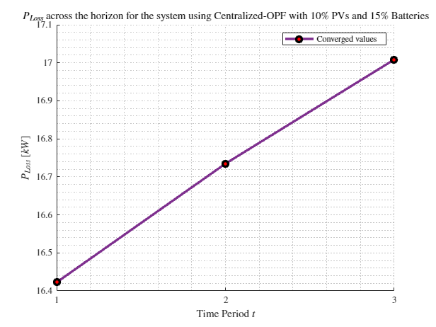
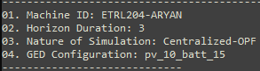
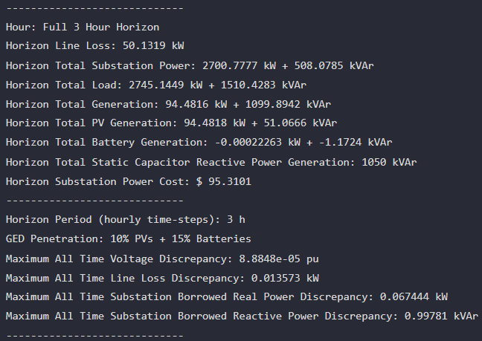
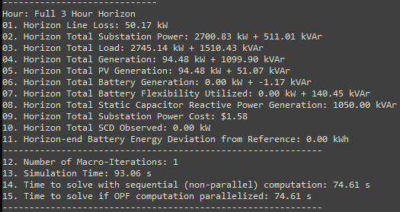

MPCOPF Verified for $T=3, PV=10\%, Batt=15\%$
strLoadShape = 'New Loadshape.LoadShape npts =3 interval = 1 mult = [0.777 0.787 0.796]'
strLoadShapePV = 'New Loadshape.LoadShapePV npts =3 interval = 1 mult = [0.8 0.9 1]'
MPDOPF Simulation Results
OpenDSS Powerflow Results
OpenDSS Def Profiles

Slide 10
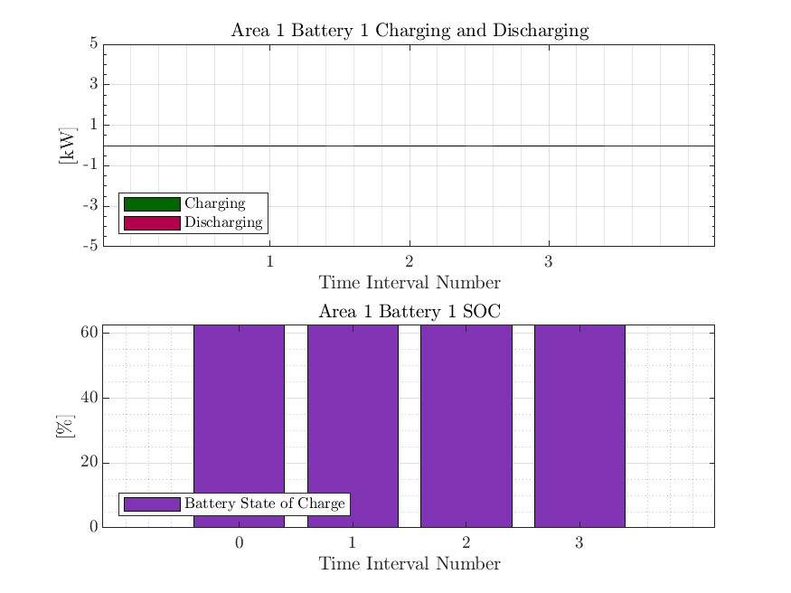




MPDOPF Verified for $T=3, PV=10\%, Batt=15\%$
strLoadShape = 'New Loadshape.LoadShape npts =3 interval = 1 mult = [0.777 0.787 0.796]'
strLoadShapePV = 'New Loadshape.LoadShapePV npts =3 interval = 1 mult = [0.8 0.9 1]'
OpenDSS Def Profiles

Slide 11




MPCOPF Verified for $T=3, PV=10\%, Batt=15\%$
strLoadShape = 'New Loadshape.LoadShape npts =3 interval = 1 mult = [0.777 0.787 0.796]'
strLoadShapePV = 'New Loadshape.LoadShapePV npts =3 interval = 1 mult = [0.8 0.9 1]'
OpenDSS Def Profiles

Slide 12
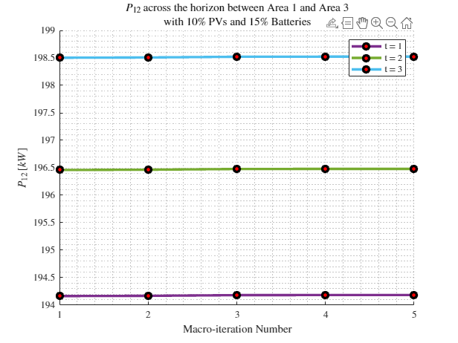
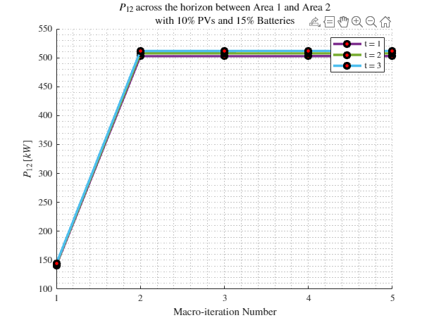
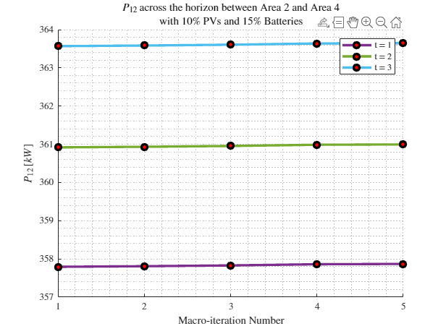

Boundary Complex Powers
strLoadShape = 'New Loadshape.LoadShape npts =3 interval = 1 mult = [0.777 0.787 0.796]'
MPDOPF Verified for $T=3, PV=10\%, Batt=15\%$
strLoadShapePV = 'New Loadshape.LoadShapePV npts =3 interval = 1 mult = [0.8 0.9 1]'
OpenDSS Def Profiles

Slide 13
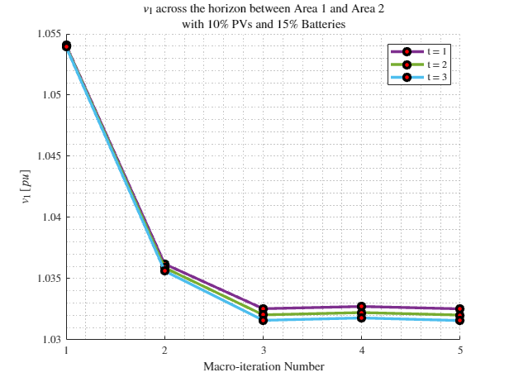
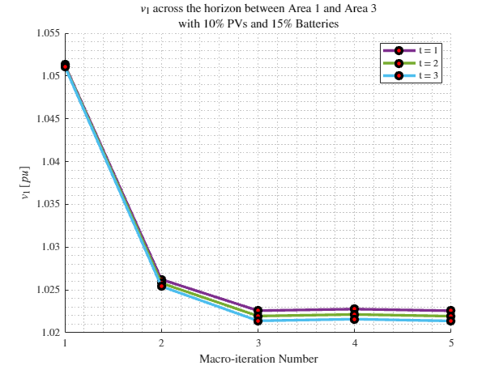
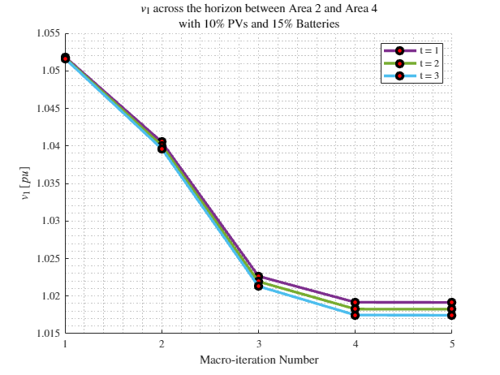
Boundary Voltages
strLoadShape = 'New Loadshape.LoadShape npts =3 interval = 1 mult = [0.777 0.787 0.796]'
MPDOPF Verified for $T=3, PV=10\%, Batt=15\%$
strLoadShapePV = 'New Loadshape.LoadShapePV npts =3 interval = 1 mult = [0.8 0.9 1]'
OpenDSS Def Profiles

Slide 14
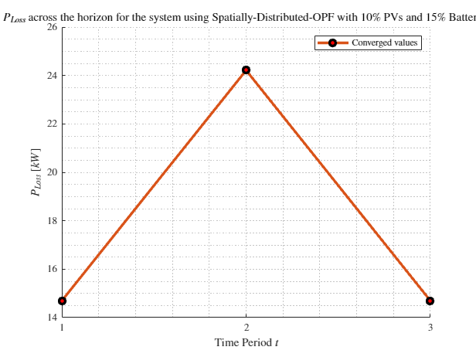
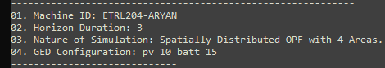
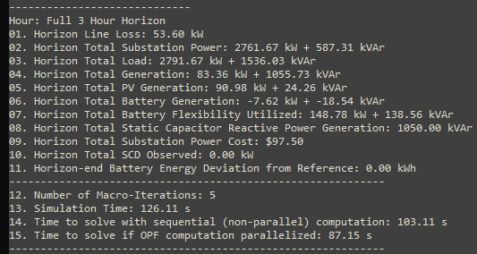
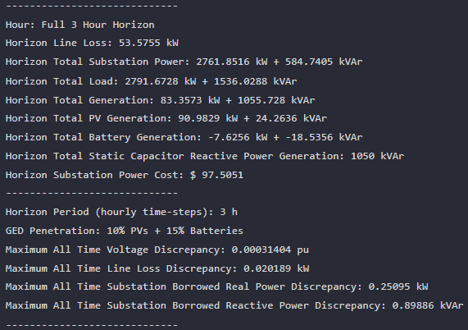
MPDOPF Verified for $T=3, PV=10\%, Batt=15\%$
strLoadShape = 'New Loadshape.LoadShape npts =3 interval = 1 mult = [0.7 1 0.7]'
strLoadShapePV = 'New Loadshape.LoadShapePV npts =3 interval = 1 mult = [0.8 1 0.8]'
MPDOPF Simulation Results
Alternative Profiles
OpenDSS Powerflow Results

Slide 15
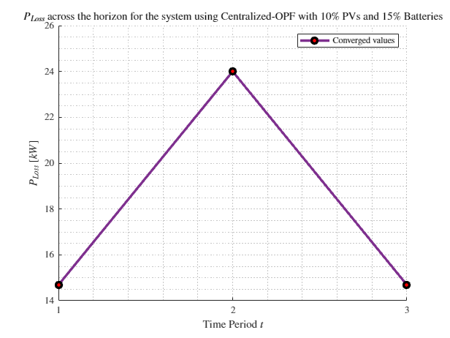
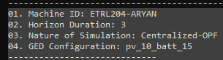
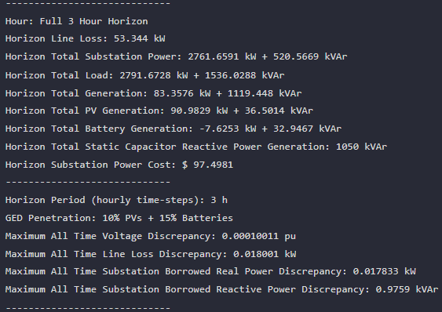
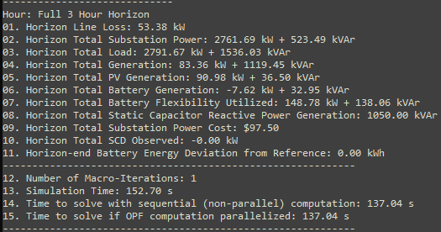

MPCOPF Verified for $T=3, PV=10\%, Batt=15\%$
strLoadShape = 'New Loadshape.LoadShape npts =3 interval = 1 mult = [0.7 1 0.7]'
strLoadShapePV = 'New Loadshape.LoadShapePV npts =3 interval = 1 mult = [0.8 1 0.8]'
MPCOPF Simulation Results
Alternative Profiles
OpenDSS Powerflow Results

Slide 16
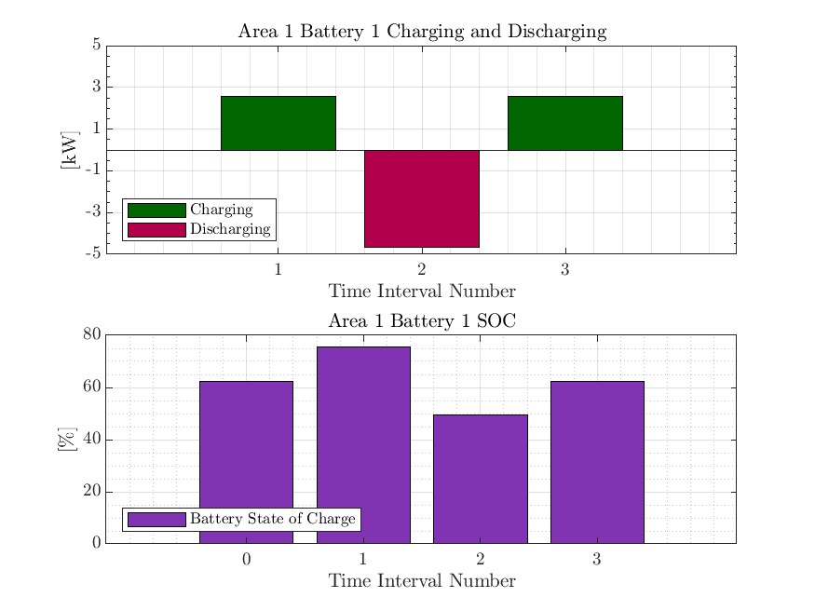
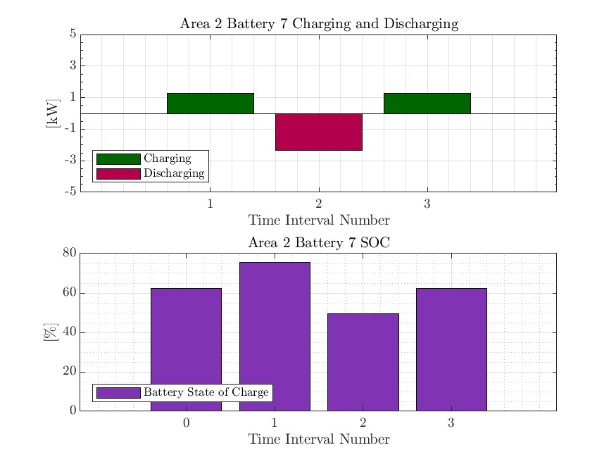


MPDOPF Verified for $T=3, PV=10\%, Batt=15\%$
strLoadShape = 'New Loadshape.LoadShape npts =3 interval = 1 mult = [0.7 1 0.7]'
strLoadShapePV = 'New Loadshape.LoadShapePV npts =3 interval = 1 mult = [0.8 1 0.8]'
Alternative Profiles

Slide 17



MPCOPF Verified for $T=3, PV=10\%, Batt=15\%$
strLoadShape = 'New Loadshape.LoadShape npts =3 interval = 1 mult = [0.7 1 0.7]'
strLoadShapePV = 'New Loadshape.LoadShapePV npts =3 interval = 1 mult = [0.8 1 0.8]'
Alternative Profiles

Slide 18
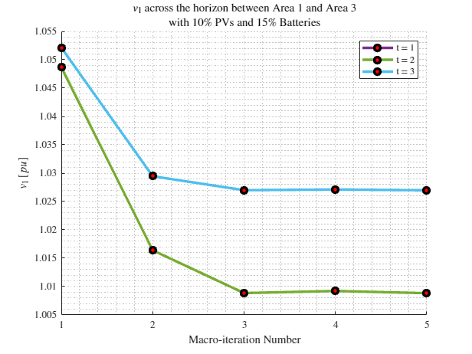
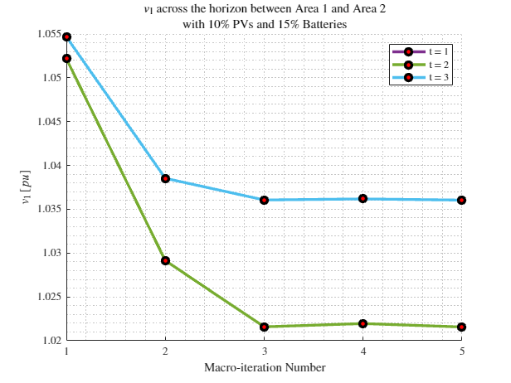
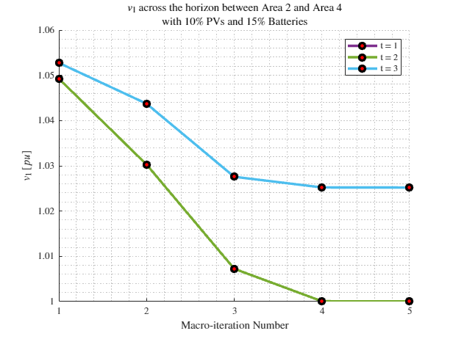
Boundary Complex Powers
strLoadShape = 'New Loadshape.LoadShape npts =3 interval = 1 mult = [0.7 1 0.7]'
MPDOPF Verified for $T=3, PV=10\%, Batt=15\%$
strLoadShapePV = 'New Loadshape.LoadShapePV npts =3 interval = 1 mult = [0.8 1 0.8]'
Alternative Profiles

Slide 19
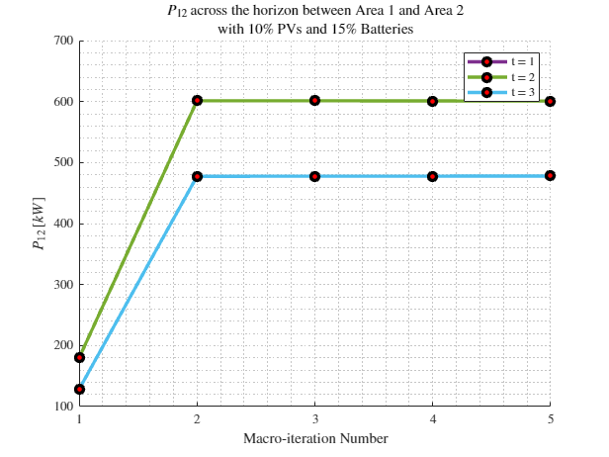
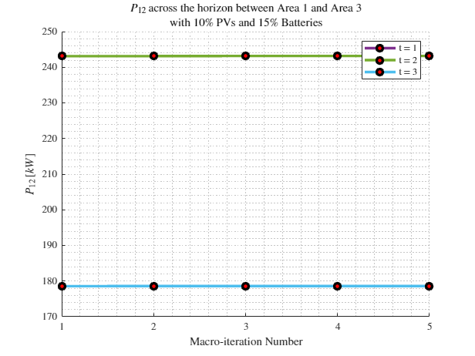
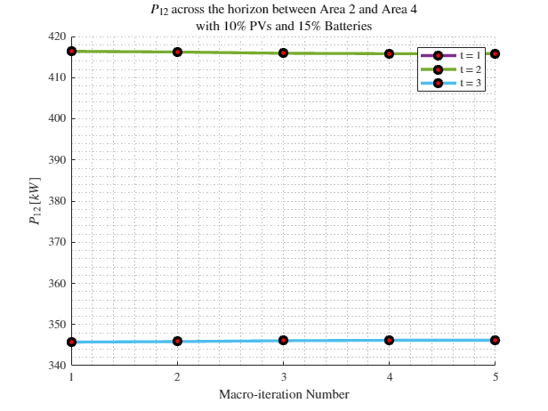
Boundary Voltages
strLoadShape = 'New Loadshape.LoadShape npts =3 interval = 1 mult = [0.7 1 0.7]'
MPDOPF Verified for $T=3, PV=10\%, Batt=15\%$
strLoadShapePV = 'New Loadshape.LoadShapePV npts =3 interval = 1 mult = [0.8 1 0.8]'
Alternative Profiles

Slide 20
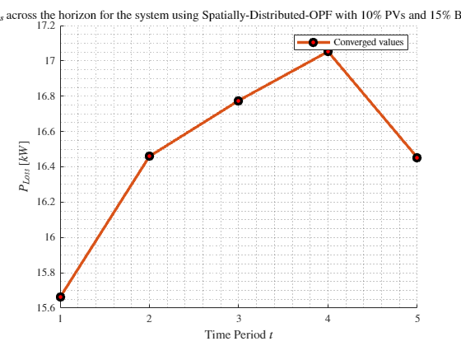
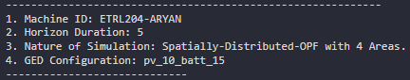
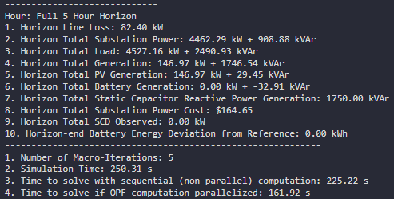


MPDOPF Verified for $T=5, PV=10\%, Batt=15\%$
strLoadShape = 'New Loadshape.LoadShape npts =5 interval = 1 mult = [0.75 0.777 0.787 0.796 0.782]'
strLoadShapePV = 'New Loadshape.LoadShapePV npts =5 interval = 1 mult = [0.5 0.8 0.9 1 1]'
MPDOPF Simulation Results
OpenDSS Powerflow Results

Slide 21





MPCOPF Verified for $T=5, PV=10\%, Batt=15\%$
strLoadShape = 'New Loadshape.LoadShape npts =5 interval = 1 mult = [0.75 0.777 0.787 0.796 0.782]'
strLoadShapePV = 'New Loadshape.LoadShapePV npts =5 interval = 1 mult = [0.5 0.8 0.9 1 1]'
MPCOPF Simulation Results
OpenDSS Powerflow Results

Slide 22




Boundary Complex Powers
MPDOPF Verified for $T=5, PV=10\%, Batt=15\%$

Slide 23



Boundary Voltages
MPDOPF Verified for $T=5, PV=10\%, Batt=15\%$

Slide 24




MPDOPF Verified for $T=5, PV=10\%, Batt=15\%$
strLoadShape = 'New Loadshape.LoadShape npts =5 interval = 1 mult = [0.7 0.85 1 0.85 0.7]'
strLoadShapePV = 'New Loadshape.LoadShapePV npts =5 interval = 1 mult = [1 1.2828 1.4 1.1 0.8]'
MPDOPF Simulation Results
Alternative Profiles
OpenDSS Powerflow Results

Slide 25




MPCOPF Verified for $T=5, PV=10\%, Batt=15\%$
strLoadShape = 'New Loadshape.LoadShape npts =5 interval = 1 mult = [0.7 0.85 1 0.85 0.7]'
strLoadShapePV = 'New Loadshape.LoadShapePV npts =5 interval = 1 mult = [1 1.2828 1.4 1.1 0.8]'
MPCOPF Simulation Results
Alternative Profiles
OpenDSS Powerflow Results

Slide 26





MPDOPF Verified for $T=10, PV=10\%, Batt=15\%$
strLoadShape = 'New Loadshape.LoadShape npts =5 interval = 1 mult = [0.7 0.85 1 0.85 0.7]'
strLoadShapePV = 'New Loadshape.LoadShapePV npts =5 interval = 1 mult = [1 1.2828 1.4 1.1 0.8]'
Alternative Profiles

Slide 27





MPCOPF Verified for $T=10, PV=10\%, Batt=15\%$
strLoadShape = 'New Loadshape.LoadShape npts =5 interval = 1 mult = [0.7 0.85 1 0.85 0.7]'
strLoadShapePV = 'New Loadshape.LoadShapePV npts =5 interval = 1 mult = [1 1.2828 1.4 1.1 0.8]'
Alternative Profiles

Slide 28



Boundary Complex Powers
strLoadShape = 'New Loadshape.LoadShape npts =5 interval = 1 mult = [0.7 0.85 1 0.85 0.7]'
MPDOPF Verified for $T=5, PV=10\%, Batt=15\%$
strLoadShapePV = 'New Loadshape.LoadShapePV npts =5 interval = 1 mult = [1 1.2828 1.4 1.1 0.8]'
Alternative Profiles

Slide 29



Boundary Voltages
strLoadShape = 'New Loadshape.LoadShape npts =5 interval = 1 mult = [0.7 0.85 1 0.85 0.7]'
MPDOPF Verified for $T=5, PV=10\%, Batt=15\%$
strLoadShapePV = 'New Loadshape.LoadShapePV npts =5 interval = 1 mult = [1 1.2828 1.4 1.1 0.8]'
Alternative Profiles

Slide 30


MPDOPF Verified for $T=8, PV=10\%, Batt=15\%$
strLoadShape = 'New Loadshape.LoadShape npts =8 interval = 1 mult = [0.705 0.75 0.777 0.787 0.796 0.782 0.783 0.789]'
strLoadShapePV = 'New Loadshape.LoadShapePV npts =8 interval = 1 mult = [0.3 0.5 0.8 0.9 1 1 0.99 0.9]'
MPDOPF Simulation Results
OpenDSS Powerflow Results

Slide 31





MPCOPF Verified for $T=8, PV=10\%, Batt=15\%$
strLoadShape = 'New Loadshape.LoadShape npts =8 interval = 1 mult = [0.705 0.75 0.777 0.787 0.796 0.782 0.783 0.789]'
strLoadShapePV = 'New Loadshape.LoadShapePV npts =8 interval = 1 mult = [0.3 0.5 0.8 0.9 1 1 0.99 0.9]'
MPCOPF Simulation Results
OpenDSS Powerflow Results

Slide 32





MPDOPF Verified for $T=8, PV=10\%, Batt=15\%$
strLoadShape = 'New Loadshape.LoadShape npts =8 interval = 1 mult = [0.705 0.75 0.777 0.787 0.796 0.782 0.783 0.789]'
1, 5, 7, 8 in COPF values
strLoadShapePV = 'New Loadshape.LoadShapePV npts =8 interval = 1 mult = [0.3 0.5 0.8 0.9 1 1 0.99 0.9]'

Slide 33





MPCOPF Verified for $T=8, PV=10\%, Batt=15\%$
strLoadShape = 'New Loadshape.LoadShape npts =8 interval = 1 mult = [0.705 0.75 0.777 0.787 0.796 0.782 0.783 0.789]'
strLoadShapePV = 'New Loadshape.LoadShapePV npts =8 interval = 1 mult = [0.3 0.5 0.8 0.9 1 1 0.99 0.9]'

Slide 34




Boundary Complex Powers
strLoadShape = 'New Loadshape.LoadShape npts =8 interval = 1 mult = [0.705 0.75 0.777 0.787 0.796 0.782 0.783 0.789]'
MPDOPF Verified for $T=8, PV=10\%, Batt=15\%$
strLoadShapePV = 'New Loadshape.LoadShapePV npts =8 interval = 1 mult = [0.3 0.5 0.8 0.9 1 1 0.99 0.9]'

Slide 35



Boundary Voltages
strLoadShape = 'New Loadshape.LoadShape npts =8 interval = 1 mult = [0.705 0.75 0.777 0.787 0.796 0.782 0.783 0.789]'
MPDOPF Verified for $T=8, PV=10\%, Batt=15\%$
strLoadShapePV = 'New Loadshape.LoadShapePV npts =8 interval = 1 mult = [0.3 0.5 0.8 0.9 1 1 0.99 0.9]'

Slide 36


MPDOPF Verified for $T=9, PV=10\%, Batt=15\%$
strLoadShape = 'New Loadshape.LoadShape npts =9 interval = 1 mult = [0.668 0.705 0.75 0.777 0.787 0.796 0.782 0.783 0.789]'
strLoadShapePV = 'New Loadshape.LoadShapePV npts =9 interval = 1 mult = [0.2 0.3 0.5 0.8 0.9 1 1 0.99 0.9]'
MPDOPF Simulation Results
OpenDSS Powerflow Results

Slide 37





MPCOPF Verified for $T=9, PV=10\%, Batt=15\%$
strLoadShape = 'New Loadshape.LoadShape npts =9 interval = 1 mult = [0.668 0.705 0.75 0.777 0.787 0.796 0.782 0.783 0.789]'
strLoadShapePV = 'New Loadshape.LoadShapePV npts =9 interval = 1 mult = [0.2 0.3 0.5 0.8 0.9 1 1 0.99 0.9]'
MPCOPF Simulation Results
OpenDSS Powerflow Results

Slide 38








MPDOPF Verified for $T=9, PV=10\%, Batt=15\%$
strLoadShape = 'New Loadshape.LoadShape npts =9 interval = 1 mult = [0.668 0.705 0.75 0.777 0.787 0.796 0.782 0.783 0.789]'
strLoadShapePV = 'New Loadshape.LoadShapePV npts =9 interval = 1 mult = [0.2 0.3 0.5 0.8 0.9 1 1 0.99 0.9]'

Slide 39








MPCOPF Verified for $T=9, PV=10\%, Batt=15\%$
strLoadShape = 'New Loadshape.LoadShape npts =9 interval = 1 mult = [0.668 0.705 0.75 0.777 0.787 0.796 0.782 0.783 0.789]'
strLoadShapePV = 'New Loadshape.LoadShapePV npts =9 interval = 1 mult = [0.2 0.3 0.5 0.8 0.9 1 1 0.99 0.9]'

Slide 40




Boundary Complex Powers
strLoadShape = 'New Loadshape.LoadShape npts =9 interval = 1 mult = [0.668 0.705 0.75 0.777 0.787 0.796 0.782 0.783 0.789]'
MPDOPF Verified for $T=9, PV=10\%, Batt=15\%$
strLoadShapePV = 'New Loadshape.LoadShapePV npts =9 interval = 1 mult = [0.2 0.3 0.5 0.8 0.9 1 1 0.99 0.9]'

Slide 41



Boundary Voltages
strLoadShape = 'New Loadshape.LoadShape npts =9 interval = 1 mult = [0.668 0.705 0.75 0.777 0.787 0.796 0.782 0.783 0.789]'
MPDOPF Verified for $T=9, PV=10\%, Batt=15\%$
strLoadShapePV = 'New Loadshape.LoadShapePV npts =9 interval = 1 mult = [0.2 0.3 0.5 0.8 0.9 1 1 0.99 0.9]'

Slide 42





MPDOPF Verified for $T=10, PV=10\%, Batt=15\%$
strLoadShape = 'New Loadshape.LoadShape npts =10 interval = 1 mult = [0.668 0.705 0.75 0.777 0.787 0.796 0.782 0.783 0.789 0.826]'
strLoadShapePV = 'New Loadshape.LoadShapePV npts =10 interval = 1 mult = [0.2 0.3 0.5 0.8 0.9 1 1 0.99 0.9 0.7]'
MPDOPF Simulation Results
OpenDSS Powerflow Results

Slide 43





MPCOPF Verified for $T=10, PV=10\%, Batt=15\%$
strLoadShape = 'New Loadshape.LoadShape npts =10 interval = 1 mult = [0.668 0.705 0.75 0.777 0.787 0.796 0.782 0.783 0.789 0.826]'
strLoadShapePV = 'New Loadshape.LoadShapePV npts =10 interval = 1 mult = [0.2 0.3 0.5 0.8 0.9 1 1 0.99 0.9 0.7]'
MPCOPF Simulation Results
OpenDSS Powerflow Results

Slide 44




MPDOPF Verified for $T=10, PV=10\%, Batt=15\%$
strLoadShape = 'New Loadshape.LoadShape npts =10 interval = 1 mult = [0.668 0.705 0.75 0.777 0.787 0.796 0.782 0.783 0.789 0.826]'
strLoadShapePV = 'New Loadshape.LoadShapePV npts =10 interval = 1 mult = [0.2 0.3 0.5 0.8 0.9 1 1 0.99 0.9 0.7]'

Slide 45



MPCOPF Verified for $T=10, PV=10\%, Batt=15\%$
strLoadShape = 'New Loadshape.LoadShape npts =10 interval = 1 mult = [0.668 0.705 0.75 0.777 0.787 0.796 0.782 0.783 0.789 0.826]'
strLoadShapePV = 'New Loadshape.LoadShapePV npts =10 interval = 1 mult = [0.2 0.3 0.5 0.8 0.9 1 1 0.99 0.9 0.7]'

Slide 46




Boundary Complex Powers
MPDOPF Verified for $T=10, PV=10\%, Batt=15\%$

Slide 47



Boundary Voltages
MPDOPF Verified for $T=10, PV=10\%, Batt=15\%$

Slide 48
MPDOPF Verified for $T=3, PV=10\%, Batt=15\%$
strLoadShape = 'New Loadshape.LoadShape npts =3 interval = 1 mult = [0.777 0.787 0.796]'
strLoadShapePV = 'New Loadshape.LoadShapePV npts =3 interval = 1 mult = [0.8 0.9 1]'
MPDOPF Simulation Results
OpenDSS Powerflow Results
OpenDSS Def Profiles

Slide 49
MPCOPF Verified for $T=3, PV=10\%, Batt=15\%$
MPDOPF Simulation Results
OpenDSS Powerflow Results
OpenDSS Def Profiles

Slide 50
MPDOPF Verified for $T=3, PV=10\%, Batt=15\%$
OpenDSS Def Profiles

Slide 51
MPCOPF Verified for $T=3, PV=10\%, Batt=15\%$
OpenDSS Def Profiles

Slide 52
Boundary Complex Powers
MPDOPF Verified for $T=3, PV=10\%, Batt=15\%$
OpenDSS Def Profiles

Slide 53
Boundary Voltages
MPDOPF Verified for $T=3, PV=10\%, Batt=15\%$
OpenDSS Def Profiles

Slide 54

Latest Slides End Here.
Previous Slides Follow

Slide 55
MPDOPF Verified for $T=5, PV=10\%, Batt=15\%$
strLoadShape = 'New Loadshape.LoadShape npts =5 interval = 1 mult = [0.75 0.777 0.787 0.796 0.782]'
strLoadShapePV = 'New Loadshape.LoadShapePV npts =5 interval = 1 mult = [0.5 0.8 0.9 1 1]'
MPDOPF Simulation Results
OpenDSS Powerflow Results

Slide 56
MPCOPF Verified for $T=5, PV=10\%, Batt=15\%$
strLoadShape = 'New Loadshape.LoadShape npts =5 interval = 1 mult = [0.75 0.777 0.787 0.796 0.782]'
strLoadShapePV = 'New Loadshape.LoadShapePV npts =5 interval = 1 mult = [0.5 0.8 0.9 1 1]'
MPCOPF Simulation Results
OpenDSS Powerflow Results

Slide 57
MPDOPF Verified for $T=10, PV=10\%, Batt=15\%$
strLoadShape = 'New Loadshape.LoadShape npts =10 interval = 1 mult = [0.668 0.705 0.75 0.777 0.787 0.796 0.782 0.783 0.789 0.826]'
strLoadShapePV = 'New Loadshape.LoadShapePV npts =10 interval = 1 mult = [0.2 0.3 0.5 0.8 0.9 1 1 0.99 0.9 0.7]'

Slide 58

MPCOPF Verified for $T=10, PV=10\%, Batt=15\%$
strLoadShape = 'New Loadshape.LoadShape npts =10 interval = 1 mult = [0.668 0.705 0.75 0.777 0.787 0.796 0.782 0.783 0.789 0.826]'
strLoadShapePV = 'New Loadshape.LoadShapePV npts =10 interval = 1 mult = [0.2 0.3 0.5 0.8 0.9 1 1 0.99 0.9 0.7]'

Slide 59
Boundary Complex Powers
strLoadShape = 'New Loadshape.LoadShape npts =10 interval = 1 mult = [0.668 0.705 0.75 0.777 0.787 0.796 0.782 0.783 0.789 0.826]'
MPDOPF Verified for $T=5, PV=10\%, Batt=15\%$
strLoadShapePV = 'New Loadshape.LoadShapePV npts =10 interval = 1 mult = [0.2 0.3 0.5 0.8 0.9 1 1 0.99 0.9 0.7]'

Slide 60
Boundary Voltages
strLoadShape = 'New Loadshape.LoadShape npts =10 interval = 1 mult = [0.668 0.705 0.75 0.777 0.787 0.796 0.782 0.783 0.789 0.826]'
MPDOPF Verified for $T=5, PV=10\%, Batt=15\%$
strLoadShapePV = 'New Loadshape.LoadShapePV npts =10 interval = 1 mult = [0.2 0.3 0.5 0.8 0.9 1 1 0.99 0.9 0.7]'

Slide 61





MPDOPF Verified for $T=1, PV=10\%, Batt=0\%$
strLoadShape = 'New Loadshape.LoadShape npts =1 interval = 1 mult = [0.787]'
strLoadShapePV = 'New Loadshape.LoadShapePV npts =1 interval = 1 mult = [0.9]'
MPDOPF Simulation Results
OpenDSS Powerflow Results

Slide 62





MPCOPF Verified for $T=1, PV=10\%, Batt=0\%$
strLoadShape = 'New Loadshape.LoadShape npts =1 interval = 1 mult = [0.787]'
strLoadShapePV = 'New Loadshape.LoadShapePV npts =1 interval = 1 mult = [0.9]'
MPCOPF Simulation Results
OpenDSS Powerflow Results

Slide 63





MPDOPF Verified for $T=1, PV=10\%, Batt=15\%$
strLoadShape = 'New Loadshape.LoadShape npts =1 interval = 1 mult = [0.787]'
strLoadShapePV = 'New Loadshape.LoadShapePV npts =1 interval = 1 mult = [0.9]'
MPDOPF Simulation Results
OpenDSS Powerflow Results

Slide 64





MPCOPF Verified for $T=1, PV=10\%, Batt=15\%$
strLoadShape = 'New Loadshape.LoadShape npts =1 interval = 1 mult = [0.787]'
strLoadShapePV = 'New Loadshape.LoadShapePV npts =1 interval = 1 mult = [0.9]'
MPCOPF Simulation Results
OpenDSS Powerflow Results

Slide 65





MPDOPF Verified for $T=2, PV=10\%, Batt=15\%$
strLoadShape = 'New Loadshape.LoadShape npts =2 interval = 1 mult = [0.787 0.796]'
strLoadShapePV = 'New Loadshape.LoadShapePV npts =2 interval = 1 mult = [0.9 1]'
MPDOPF Simulation Results
OpenDSS Powerflow Results

Slide 66





MPCOPF Verified for $T=2, PV=10\%, Batt=15\%$
strLoadShape = 'New Loadshape.LoadShape npts =2 interval = 1 mult = [0.787 0.796]'
strLoadShapePV = 'New Loadshape.LoadShapePV npts =2 interval = 1 mult = [0.9 1]'
MPCOPF Simulation Results
OpenDSS Powerflow Results

Slide 67

MPDOPF Verified for $T=3, PV=10\%, Batt=15\%$
strLoadShape = 'New Loadshape.LoadShape npts =3 interval = 1 mult = [0.777 0.787 0.796]'
strLoadShapePV = 'New Loadshape.LoadShapePV npts =3 interval = 1 mult = [0.8 0.9 1]'
MPDOPF Simulation Results
OpenDSS Powerflow Results

Slide 68




MPCOPF Verified for $T=3, PV=10\%, Batt=15\%$
strLoadShape = 'New Loadshape.LoadShape npts =3 interval = 1 mult = [0.777 0.787 0.796]'
strLoadShapePV = 'New Loadshape.LoadShapePV npts =3 interval = 1 mult = [0.8 0.9 1]'
MPCOPF Simulation Results
OpenDSS Powerflow Results

Slide 69




MPDOPF Verified for $T=5, PV=10\%, Batt=15\%$
strLoadShape = 'New Loadshape.LoadShape npts =5 interval = 1 mult = [0.75 0.777 0.787 0.796 0.782]'
strLoadShapePV = 'New Loadshape.LoadShapePV npts =5 interval = 1 mult = [0.5 0.8 0.9 1 1]'
MPDOPF Simulation Results
OpenDSS Powerflow Results

Slide 70




MPCOPF Verified for $T=5, PV=10\%, Batt=15\%$
strLoadShape = 'New Loadshape.LoadShape npts =5 interval = 1 mult = [0.75 0.777 0.787 0.796 0.782]'
strLoadShapePV = 'New Loadshape.LoadShapePV npts =5 interval = 1 mult = [0.5 0.8 0.9 1 1]'
MPCOPF Simulation Results
OpenDSS Powerflow Results

Slide 71





MPDOPF Verified for $T=5, PV=10\%, Batt=15\%$
strLoadShape = 'New Loadshape.LoadShape npts =5 interval = 1 mult = [0.75 0.777 0.787 0.796 0.782]'
strLoadShapePV = 'New Loadshape.LoadShapePV npts =5 interval = 1 mult = [0.5 0.8 0.9 1 1]'

Slide 72





MPCOPF Verified for $T=5, PV=10\%, Batt=15\%$
strLoadShape = 'New Loadshape.LoadShape npts =5 interval = 1 mult = [0.75 0.777 0.787 0.796 0.782]'
strLoadShapePV = 'New Loadshape.LoadShapePV npts =5 interval = 1 mult = [0.5 0.8 0.9 1 1]'

Slide 73



Boundary Complex Powers
MPDOPF Verified for $T=5, PV=10\%, Batt=15\%$

Slide 74



Boundary Voltages
MPDOPF Verified for $T=5, PV=10\%, Batt=15\%$

Slide 75




MPDOPF Verified for $T=10, PV=10\%, Batt=15\%$
strLoadShape = 'New Loadshape.LoadShape npts =10 interval = 1 mult = [0.668 0.705 0.75 0.777 0.787 0.796 0.782 0.783 0.789 0.826]'
strLoadShapePV = 'New Loadshape.LoadShapePV npts =10 interval = 1 mult = [0.2 0.3 0.5 0.8 0.9 1 1 0.99 0.9 0.7]'
MPDOPF Simulation Results
OpenDSS Powerflow Results

Slide 76




MPCOPF Verified for $T=10, PV=10\%, Batt=15\%$
strLoadShape = 'New Loadshape.LoadShape npts =10 interval = 1 mult = [0.668 0.705 0.75 0.777 0.787 0.796 0.782 0.783 0.789 0.826]'
strLoadShapePV = 'New Loadshape.LoadShapePV npts =10 interval = 1 mult = [0.2 0.3 0.5 0.8 0.9 1 1 0.99 0.9 0.7]'
MPCOPF Simulation Results
OpenDSS Powerflow Results

Slide 77





MPDOPF Verified for $T=10, PV=10\%, Batt=15\%$
strLoadShape = 'New Loadshape.LoadShape npts =10 interval = 1 mult = [0.668 0.705 0.75 0.777 0.787 0.796 0.782 0.783 0.789 0.826]'
strLoadShapePV = 'New Loadshape.LoadShapePV npts =10 interval = 1 mult = [0.2 0.3 0.5 0.8 0.9 1 1 0.99 0.9 0.7]'

Slide 78





MPCOPF Verified for $T=10, PV=10\%, Batt=15\%$
strLoadShape = 'New Loadshape.LoadShape npts =10 interval = 1 mult = [0.668 0.705 0.75 0.777 0.787 0.796 0.782 0.783 0.789 0.826]'
strLoadShapePV = 'New Loadshape.LoadShapePV npts =10 interval = 1 mult = [0.2 0.3 0.5 0.8 0.9 1 1 0.99 0.9 0.7]'

Slide 79



Boundary Complex Powers
MPDOPF Verified for $T=10, PV=10\%, Batt=15\%$

Slide 80



Boundary Voltages
MPDOPF Verified for $T=10, PV=10\%, Batt=15\%$

Slide 81

MPDOPF Verified for $T=t, PV=10\%, Batt=15\%$
strLoadShape = 'New Loadshape.LoadShape npts =1 interval = 1 mult = [0.787]'
strLoadShapePV = 'New Loadshape.LoadShapePV npts =1 interval = 1 mult = [0.9]'
MPDOPF Simulation Results
OpenDSS Powerflow Results

Slide 82

MPCOPF Verified for $T=t, PV=10\%, Batt=15\%$
strLoadShape = 'New Loadshape.LoadShape npts =1 interval = 1 mult = [0.787]'
strLoadShapePV = 'New Loadshape.LoadShapePV npts =1 interval = 1 mult = [0.9]'
MPCOPF Simulation Results
OpenDSS Powerflow Results

Slide 83









MPDOPF Verified for $T=1, PV=10\%, Batt=10\%$
strLoadShape = 'New Loadshape.LoadShape npts =1 interval = 1 mult = [0.787]'
strLoadShapePV = 'New Loadshape.LoadShapePV npts =1 interval = 1 mult = [0.9]'
MPDOPF Simulation Results
OpenDSS Powerflow Results
$10\%$GED = $11$ buses

Slide 84








MPCOPF Verified for $T=1, PV=10\%, Batt=10\%$
strLoadShape = 'New Loadshape.LoadShape npts =1 interval = 1 mult = [0.787]'
strLoadShapePV = 'New Loadshape.LoadShapePV npts =1 interval = 1 mult = [0.9]'
MPCOPF Simulation Results
OpenDSS Powerflow Results
$10\%$GED = $11$ buses

Slide 85






MPDOPF Verified for $T=1, PV=100\%, Batt=100\%$
strLoadShape = 'New Loadshape.LoadShape npts =1 interval = 1 mult = [0.787]'
strLoadShapePV = 'New Loadshape.LoadShapePV npts =1 interval = 1 mult = [0.9]'
MPDOPF Simulation Results
OpenDSS Powerflow Results
$100\%$GED = $85$ buses

Slide 86





MPCOPF Verified for $T=1, PV=100\%, Batt=100\%$
strLoadShape = 'New Loadshape.LoadShape npts =1 interval = 1 mult = [0.787]'
strLoadShapePV = 'New Loadshape.LoadShapePV npts =1 interval = 1 mult = [0.9]'
MPCOPF Simulation Results
OpenDSS Powerflow Results
$100\%$GED = $85$ buses

Slide 87






MPDOPF Verified for $T=5, PV=10\%, Batt=10\%$
strLoadShape = 'New Loadshape.LoadShape npts =5 interval = 1 mult = [0.75 0.777 0.787 0.796 0.782]'
strLoadShapePV = 'New Loadshape.LoadShapePV npts =5 interval = 1 mult = [0.5 0.8 0.9 1 1]'
MPDOPF Simulation Results
OpenDSS Powerflow Results
$10\%$GED = $11$ buses

Slide 88






MPCOPF Verified for $T=5, PV=10\%, Batt=10\%$
strLoadShape = 'New Loadshape.LoadShape npts =5 interval = 1 mult = [0.75 0.777 0.787 0.796 0.782]'
strLoadShapePV = 'New Loadshape.LoadShapePV npts =5 interval = 1 mult = [0.5 0.8 0.9 1 1]'
MPCOPF Simulation Results
OpenDSS Powerflow Results
$10\%$GED = $9$ buses

Slide 89





MPDOPF Verified for $T=6, PV=10\%, Batt=10\%$
strLoadShape = 'New Loadshape.LoadShape npts =6 interval = 1 mult = [0.75 0.777 0.787 0.796 0.782 0.783]'
strLoadShapePV = 'New Loadshape.LoadShapePV npts =6 interval = 1 mult = [0.5 0.8 0.9 1 1 0.99]'
MPDOPF Simulation Results
OpenDSS Powerflow Results
$10\%$GED = $11$ buses

Slide 90





MPCOPF Verified for $T=6, PV=10\%, Batt=10\%$
strLoadShape = 'New Loadshape.LoadShape npts =6 interval = 1 mult = [0.75 0.777 0.787 0.796 0.782 0.783]'
strLoadShapePV = 'New Loadshape.LoadShapePV npts =6 interval = 1 mult = [0.5 0.8 0.9 1 1 0.99]'
MPCOPF Simulation Results
OpenDSS Powerflow Results
$10\%$GED = $9$ buses

Slide 91





MPDOPF Verified for $T=7, PV=10\%, Batt=10\%$
strLoadShape = 'New Loadshape.LoadShape npts =7 interval = 1 mult = [0.705 0.75 0.777 0.787 0.796 0.782 0.783]'
strLoadShapePV = 'New Loadshape.LoadShapePV npts =7 interval = 1 mult = [0.3 0.5 0.8 0.9 1 1 0.99]'
MPDOPF Simulation Results
OpenDSS Powerflow Results
$10\%$GED = $11$ buses

Slide 92





MPCOPF Verified for $T=7, PV=10\%, Batt=10\%$
strLoadShape = 'New Loadshape.LoadShape npts =7 interval = 1 mult = [0.705 0.75 0.777 0.787 0.796 0.782 0.783]'
strLoadShapePV = 'New Loadshape.LoadShapePV npts =7 interval = 1 mult = [0.3 0.5 0.8 0.9 1 1 0.99]'
MPCOPF Simulation Results
OpenDSS Powerflow Results
$10\%$GED = $9$ buses

Slide 93





MPDOPF Verified for $T=8, PV=10\%, Batt=10\%$
strLoadShape = 'New Loadshape.LoadShape npts =8 interval = 1 mult = [0.705 0.75 0.777 0.787 0.796 0.782 0.783 0.789]'
strLoadShapePV = 'New Loadshape.LoadShapePV npts =8 interval = 1 mult = [0.3 0.5 0.8 0.9 1 1 0.99 0.9]'
MPDOPF Simulation Results
OpenDSS Powerflow Results
$10\%$GED = $11$ buses

Slide 94





MPCOPF Verified for $T=8, PV=10\%, Batt=10\%$
strLoadShape = 'New Loadshape.LoadShape npts =8 interval = 1 mult = [0.705 0.75 0.777 0.787 0.796 0.782 0.783 0.789]'
strLoadShapePV = 'New Loadshape.LoadShapePV npts =8 interval = 1 mult = [0.3 0.5 0.8 0.9 1 1 0.99 0.9]'
MPCOPF Simulation Results
OpenDSS Powerflow Results
$10\%$GED = $9$ buses

Slide 95





MPDOPF Verified for $T=9, PV=10\%, Batt=10\%$
strLoadShape = 'New Loadshape.LoadShape npts =9 interval = 1 mult = [0.668 0.705 0.75 0.777 0.787 0.796 0.782 0.783 0.789]'
strLoadShapePV = 'New Loadshape.LoadShapePV npts =9 interval = 1 mult = [0.2 0.3 0.5 0.8 0.9 1 1 0.99 0.9]'
MPDOPF Simulation Results
OpenDSS Powerflow Results
$10\%$GED = $11$ buses

Slide 96





MPCOPF Verified for $T=9, PV=10\%, Batt=10\%$
strLoadShape = 'New Loadshape.LoadShape npts =9 interval = 1 mult = [0.668 0.705 0.75 0.777 0.787 0.796 0.782 0.783 0.789]'
strLoadShapePV = 'New Loadshape.LoadShapePV npts =9 interval = 1 mult = [0.2 0.3 0.5 0.8 0.9 1 1 0.99 0.9]'
MPCOPF Simulation Results
OpenDSS Powerflow Results
$10\%$GED = $9$ buses

Slide 97





MPDOPF Verified for $T=10, PV=10\%, Batt=10\%$
strLoadShape = 'New Loadshape.LoadShape npts =10 interval = 1 mult = [0.668 0.705 0.75 0.777 0.787 0.796 0.782 0.783 0.789 0.826]'
strLoadShapePV = 'New Loadshape.LoadShapePV npts =10 interval = 1 mult = [0.2 0.3 0.5 0.8 0.9 1 1 0.99 0.9 0.7]'
MPDOPF Simulation Results
OpenDSS Powerflow Results
$10\%$GED = $11$ buses

Slide 98





MPCOPF Verified for $T=10, PV=10\%, Batt=10\%$
strLoadShape = 'New Loadshape.LoadShape npts =10 interval = 1 mult = [0.668 0.705 0.75 0.777 0.787 0.796 0.782 0.783 0.789 0.826]'
strLoadShapePV = 'New Loadshape.LoadShapePV npts =10 interval = 1 mult = [0.2 0.3 0.5 0.8 0.9 1 1 0.99 0.9 0.7]'
MPCOPF Simulation Results
OpenDSS Powerflow Results
$10\%$GED = $9$ buses

Slide 99





MPDOPF Verified for $T=10, PV=10\%, Batt=10\%$
strLoadShape = 'New Loadshape.LoadShape npts =10 interval = 1 mult = [0.668 0.705 0.75 0.777 0.787 0.796 0.782 0.783 0.789 0.826]'
strLoadShapePV = 'New Loadshape.LoadShapePV npts =10 interval = 1 mult = [0.2 0.3 0.5 0.8 0.9 1 1 0.99 0.9 0.7]'

Slide 100



Boundary Complex Powers

Slide 101



Boundary Voltages

Slide 102





MPDOPF Verified for $T=11, PV=10\%, Batt=10\%$
strLoadShape = 'New Loadshape.LoadShape npts =11 interval = 1 mult = [0.644 0.668 0.705 0.75 0.777 0.787 0.796 0.782 0.783 0.789 0.826]'
strLoadShapePV = 'New Loadshape.LoadShapePV npts =11 interval = 1 mult = [0.1 0.2 0.3 0.5 0.8 0.9 1 1 0.99 0.9 0.7]'
MPDOPF Simulation Results
OpenDSS Powerflow Results
$10\%$GED = $11$ buses

Slide 103





MPCOPF Verified for $T=11, PV=10\%, Batt=10\%$
strLoadShape = 'New Loadshape.LoadShape npts =11 interval = 1 mult = [0.644 0.668 0.705 0.75 0.777 0.787 0.796 0.782 0.783 0.789 0.826]'
strLoadShapePV = 'New Loadshape.LoadShapePV npts =11 interval = 1 mult = [0.1 0.2 0.3 0.5 0.8 0.9 1 1 0.99 0.9 0.7]'
MPCOPF Simulation Results
OpenDSS Powerflow Results
$10\%$GED = $9$ buses

Slide 104


MPDOPF Verification: $$T=1, PV=30\%, Batt=30\%$$

Slide 105





MPDOPF Verified for $T=1, PV=30\%, Batt=30\%$
MPDOPF Simulation Results
OpenDSS Powerflow Results

Slide 106



MPDOPF Verification: $$T=2, PV=30\%, Batt=30\%$$

Slide 107






MPDOPF Verified for $T=2, PV=30\%, Batt=30\%$
MPDOPF Simulation Results
OpenDSS Powerflow Results

Slide 108




MPDOPF Verification: $$T=3, PV=10\%, Batt=10\%$$

Slide 109






MPDOPF Verified for $T=3, PV=10\%, Batt=10\%$
MPDOPF Simulation Results
OpenDSS Powerflow Results

Slide 110



MPDOPF Verification: $$T=4, PV=10\%, Batt=10\%$$

Slide 111






MPDOPF Verified for $T=4, PV=10\%, Batt=10\%$
strLoadShape = 'New Loadshape.LoadShape npts =4 interval = 1 mult = [0.777 0.787 0.796 0.782]'
strLoadShapePV = 'New Loadshape.LoadShapePV npts =4 interval = 1 mult = [0.8 0.9 1 1]'
MPDOPF Simulation Results
OpenDSS Powerflow Results

Slide 112



MPDOPF Verification: $$T=5, PV=10\%, Batt=10\%$$

Slide 113



MPDOPF Verification: $$T=5, PV=30\%, Batt=30\%$$

Slide 114





MPCOPF $T=5, PV=30\%, Batt=30\%$

Slide 115



MPDOPF Verification: $$T=5, PV=50\%, Batt=50\%$$

Slide 116





MPCOPF $T=5, PV=50\%, Batt=50\%$ sim terminated at 100 micro-iterations

Slide 117



MPDOPF Verification: $$T=5, PV=100\%, Batt=100\%$$

Slide 118



MPDOPF Verification: $$T=6, PV=10\%, Batt=10\%$$

Slide 119






MPDOPF Verified for $T=5, PV=30\%, Batt=30\%$
strLoadShape = 'New Loadshape.LoadShape npts =5 interval = 1 mult = [0.75 0.777 0.787 0.796 0.782]'
strLoadShapePV = 'New Loadshape.LoadShapePV npts =5 interval = 1 mult = [0.5 0.8 0.9 1 1]'
MPDOPF Simulation Results
OpenDSS Powerflow Results

Slide 120






MPDOPF Verified for $T=5, PV=50\%, Batt=50\%$
strLoadShape = 'New Loadshape.LoadShape npts =5 interval = 1 mult = [0.75 0.777 0.787 0.796 0.782]'
strLoadShapePV = 'New Loadshape.LoadShapePV npts =5 interval = 1 mult = [0.5 0.8 0.9 1 1]'
MPDOPF Simulation Results
OpenDSS Powerflow Results

Slide 121






MPDOPF Verified for $T=5, PV=100\%, Batt=100\%$
strLoadShape = 'New Loadshape.LoadShape npts =5 interval = 1 mult = [0.75 0.777 0.787 0.796 0.782]'
strLoadShapePV = 'New Loadshape.LoadShapePV npts =5 interval = 1 mult = [0.5 0.8 0.9 1 1]'
MPDOPF Simulation Results
OpenDSS Powerflow Results

Slide 122


MPDOPF: Mapping of Decentralized Variables to Centralized Variables done, everything packed into a structure suitable for OpenDSS Validation.
I had node numbers for $4$ Areas like $1:41$, $1:19, 1:20, 1:54$ but not a way to know which nodes do they refer to in the real ‘centralized’ system.
I (manually) created a mapping between the two.
I then used the mapping scheme to collate all ‘area information’ after optimization into a ‘system information’ for validating against OpenDSS.

Slide 123

How do other authors validate their OPF results?
[nazir2020tpwrs]
Feasibility of Solution: Forward-Backward Sweep in GridLab-D.
They check violation of node voltages between the simulation and the GridLab-D powerflow.
Optimality of Solution:
The authors argue that a) computing (even for verifying) Multi-Period NL OPF can be computationally too expensive and b) the solution to a ‘Decoupled’ NL-OPF (with battery set points already assigned by the Full Horizon SOCP OPF will provide an even lower optimal value compared to the Full Horizon NLP OPF (7).

Slide 124


How do other authors validate their OPF results?
[nazir2020tpwrs]
Optimality of Solution:
They formulate their optimality gap as a comparison between the SOCP optimal value and Decoupled NLP optimal value (9), for each time-step, and taking the maximum optimality gap to show as the result.
For IEEE 123, they get a maximum optimality gap of $2.1\%$. Violations against GridLab-D are small. (Feasible solution).

Slide 125

How do other authors validate their OPF results?
[nazir2020tpwrs]
Commentary on Solution Times:
Fig. (a) They see a similar trend in results as me when performing a Full Horizon NLP, with solution times becoming increasingly larger as the time-horizon increases.
Fig. (b) But their SOCP approach scales well, with solutions times increasingly almost linearly with time-horizon. For practical scenarios (day-ahead hourly simulation), their SOCP solution converges in under a minute.

Slide 126


How do other authors validate their OPF results?
[usman2022tpwrs]
Feasibility and Optimality of Solution:
They mainly showcase the benchmarks based on UK $31$ bus system.
They solve the full horizon (day-ahead hourly) OPF MINLP OPF in JuMP using BONMIN solver (here called $M0$).
They compare its objective function against their own linearized method (here called $M1$).
They get an optimality gap of less than $1\%$.
Infeasibilities are detected based on box-constraints (line-limits breached, bus voltage limits breached, etc.).

Slide 127
How do other authors validate their OPF results?
[agrawal2022tpwrs]
Other authors, sometimes use a different solution paradigm, and compare it against MATLAB’s fmincon.

Slide 128






MPCOPF Simulation has been verified for X% PVs and Y% Batteries Only for small horizons ($T≤8$) because of long simulation time.

Slide 129




$$T=1, PV=10\%, Batt=10\%$$

Slide 130





$$T=2, PV=10\%, Batt=10\%$$

Slide 131




$$T=2, PV=30\%, Batt=30\%$$

Slide 132





$$T=3, PV=10\%, Batt=10\%$$

Slide 133





$$T=4, PV=10\%, Batt=10\%$$

Slide 134





$$T=5, PV=10\%, Batt=10\%$$

Slide 135

$$T=5, PV=30\%, Batt=30\%$$

Slide 136


$$T=5, PV=30\%, Batt=30\%$$

Slide 137

$$T=5, PV=50\%, Batt=50\%$$ sim terminated at 100 micro-iterations

Slide 138


$$T=5, PV=50\%, Batt=50\%$$ sim terminated at 100 micro-iterations

Slide 139





$$T=6, PV=10\%, Batt=10\%$$

Slide 140


$$T=6, PV=10\%, Batt=10\%$$

Slide 141





$$T=7,PV=10\%, Batt=10\%$$

Slide 142





$$T=8,PV=10\%, Batt=10\%$$

Slide 143


$$T=8,PV=10\%, Batt=10\%$$

Slide 144





$$T=9,PV=10\%, Batt=10\%$$

Slide 145




$$T=1, PV=30\%, Batt=30\%$$

Slide 146





$$T=6, PV=30\%, Batt=30\%$$

Slide 147





$$T=6, PV=50\%, Batt=50\%$$

Slide 148

MPCOPF Simulation has been verified for X% PVs and Y% Batteries Only for small horizons ($T=5$) because of long simulation time.
MPCOPF Simulation Results
These slides will show results for a $5$-hour (hourly) $10\%$ PV $+ 10\%$Battery Simulation Validation for IEEE $123$ system, but I’ve validated for many other percentage penetrations too, for smaller time-steps.
For example, even this simulation took $500$ seconds on my $32$GB Office PC.
Even for the same $T$, increasing the GED penetration % increases the OPF solution time.
And even for small GED penetration percentage (10% each like the one done in these slides), increasing $T$ increases the simulation time by a lot.

Slide 149





MPCOPF Simulation has been verified for X% PVs and Y% Batteries Only for small horizons ($T≤5$) because of long simulation time.
MPCOPF Simulation Results
OpenDSS Powerflow Results
$10\%$ PVs + $10\%$ Batteries

Slide 150



Current Issue: Some mismatch in MPCOPF results Seeming mismatch between specified (from OPF) and assigned values (into OpenDSS) for Battery Reactive Powers

Slide 151




Currently Doing: Extracting Results on an Hourly (Time-step) Basis, for hourly comparison against OpenDSS

Slide 152





IEEE $123 X\%$PVs, $0\%$Batteries. COPF. $T = 1$
Objective Function values (Real Power Losses $P_{Loss}$) and System-wide Voltage snapshots (shown in the next slides) match.
This slide: $X=0$
Multi-Period Simulation, T = 1, Batteries at 0%, DERs at 0% ($0$ buses)
OpenDSS Powerflow with DERs at 0% ($0$ buses)

Slide 153




IEEE $123 X\%$PVs, $0\%$Batteries. COPF. $T = 1$
Objective Function values (Real Power Losses $P_{Loss}$) and System-wide Voltage snapshots (shown in the next slides) match.
This slide: $X=50$
Multi-Period Simulation, T = 1, Batteries at 0%, DERs at 50% ($43$ buses)
OpenDSS Powerflow with DERs at 50% ($43$ buses)

Slide 154




IEEE $123 X\%$PVs, $0\%$Batteries. COPF. $T = 1$
Objective Function values (Real Power Losses $P_{Loss}$) and System-wide Voltage snapshots (shown in the next slides) match.
This slide: $X=100$
Multi-Period Simulation, T = 1, Batteries at 0%, DERs at 100% ($85$ buses)
OpenDSS Powerflow with DERs at 100% ($85$ buses)

Slide 155







Comparison with OpenDSS: System-wide Voltage Snapshots PV = $0\%, 10\%, 20\%, 30\%, 40\%, 50\%$ Battery = $0\%$ $$T = 1$$

Slide 156






Comparison with OpenDSS: System-wide Voltage Snapshots PV = $60\%, 70\%, 80\%, 90\%, 100\%,$ Battery = $0\%$ $$T = 1$$

Slide 157






Comparison with OpenDSS: System-wide Voltage Snapshots Battery = $10\%, 20\%, 30\%, 40\%, 50\%$ PV = $0\%$ $$T = 1$$

Slide 158






Comparison with OpenDSS: System-wide Voltage Snapshots
PV = $0\%$ Battery = $60\%, 70\%, 80\%, 90\%, 100\%,$ $$T = 1$$

Slide 159






Comparison with OpenDSS: System-wide Voltage Snapshots
PV and Battery = $0\%, 10\%, 30\%, 50\%, 100\%$ $$T = 1$$

Slide 160





Trying to benchmark the “Benchmark” Simulation against the “Original” Simulation
$T$: Number of Time-Periods (tunable)
No Time-dimension: Equivalent to $T=1$
$numAreas$ : Number of Areas the system is divided into. The simulation becomes:
CMPOPF if $numAreas = 1$
DMPOPF if $numAreas > 1 (4)$
$numAreas$ : Number of Areas the system is divided into. The simulation becomes:
CMPOPF if $numAreas = 1$
DMPOPF if $numAreas > 1 (4)$
DERs (tunable): $[0, 100\%]$ ($0$ to $85$ buses)
Batteries# (tunable*): $[0, 100\%]$ ($0$ to $85$buses)
DERs (fixed): $100\%$ ($85$ buses)
No Batteries: Equivalent to $0\%$ ($0$ buses)
“Benchmark” Simulation: MP-(C/D)-OPF
“Original” Simulation: (C/D)-OPF

Slide 161








Trying to benchmark the “Benchmark” Simulation against the “Original” Simulation
#Batteries add more than just $4$ new decision variables (which are $B, P_{c}, P_{d}, q_{B}$) to the simulation.
Incorporating them (while avoiding mixed-integer programming) requires specifying additional ‘soft-constraint’ objective functions to the optimizer, including an “SCD penalty” function and a “Deviation of terminal SOC from a reference SOC penalty” function, which require additional unknown parameters (such as $α, γ$ in my simulation). Ideally, these ‘soft-constraint’ function values in the result should be zero, but if this doesn’t happen, they cannot be truly compared to a ‘battery-free’ simulation.
$T$: Number of Time-Periods (tunable)
No Time-dimension: Like $T=1$
$numAreas$ : Number of Areas the system is divided into. The simulation becomes:
CMPOPF if $numAreas = 1$
DMPOPF if $numAreas > 1 (4)$
$numAreas$ : Number of Areas the system is divided into. The simulation becomes:
CMPOPF if $numAreas = 1$
DMPOPF if $numAreas > 1 (4)$
DERs (tunable): $[0, 100\%]$ ($0$ to $85$ buses)
Batteries# (tunable*): $[0, 100\%]$ ($0$ to $85$buses)
DERs (fixed): $100\%$ ($85$ buses)
No Batteries: Like $0\%$ ($0$ buses)
“Benchmark” Simulation: MP-(C/D)-OPF
“Original” Simulation: (C/D)-OPF
*Note: The way the batteries are currently modeled, they can only be placed at a bus where there is already a DER. (So only $85$ buses are eligible to have a battery)

Slide 162







Trying to benchmark the “Benchmark” Simulation against the “Original” Simulation
But, if batteries are removed (unmodeled) from the MPOPF simulation, the previously mentioned complications are also avoided, and thus the two simulations can be compared toe-to-toe. This is what I’ve been doing recently.
$T$: Number of Time-Periods (tunable)
$$T=1$$
$numAreas=1$ (COPF)
$$\%DER=100$$
$$\%Batteries=0$$
No Time-dimension: Equivalent to $T=1$
$numAreas$ : Number of Areas the system is divided into. The simulation becomes:
CMPOPF if $numAreas = 1$
DMPOPF if $numAreas > 1 (4)$
$numAreas$ : Number of Areas the system is divided into. The simulation becomes:
CMPOPF if $numAreas = 1$
DMPOPF if $numAreas > 1 (4)$
DERs (tunable): $[0, 100\%]$ ($0$ to $85$ buses)
Batteries# (tunable*): $[0, 100\%]$ ($0$ to $85$buses)
DERs (fixed): $100\%$ ($85$ buses)
No Batteries: Equivalent to $0\%$ ($0$ buses)
“Benchmark” Simulation: MP-(C/D)-OPF
“Original” Simulation: (C/D)-OPF

Slide 163


IEEE $123 100\%$DER, $0\%$Batteries. COPF. $T = 1$
Current Status: My MPCOPF line loss result matches with the previous COPF line loss results, which still is a little off the OpenDSS line loss. Voltages (on the next page) match closely, but not completely. I don’t know the cause of the slight mismatch. (and whether it will blow up for bigger simulations, or not be an issue)
Multi-Period Simulation, T = 1, Batteries at 0%, DERs at 100% ($85$ buses)
OpenDSS Powerflow with DERs at 100% ($85$ buses)

Slide 164


Comparison with OpenDSS

Slide 165




IEEE $123 100\%$DER, $0\%$Batteries. COPF. $T = 1$
Problem: These values should be the same. This is an OPF modelling issue.
Multi-Period Simulation, T = 1, Batteries at 0%, DERs at 100% ($85$ buses)
Original Simulation* DERs at 100% ($85$ buses)
* Original Simulation = Simulation used by Rabayet to model DOPF on IEEE $123$ Bus System with $100\%$ DERs ($85$ buses). Obviously, there’s no element of time $($not modeled, so $T=1)$ and no batteries (not modeled, so $0\%$)

Slide 166

Current Approach: Validating OPF decision variables with OpenDSS
By setting
$P_{Load_OpenDSS}=P_{Load} −P_{DER} −P_{disch}+P_{chr}$
$Q_{Load_OpenDSS}=Q_{Load} −q_{DER} −q_{Batt}−Q_{Cap}$
Running Powerflow in OpenDSS, obtaining $V_{OpenDSS}$ and comparing against my simulation $V_{results}$ (checking for physical violations, but also, just checking the two $V$vs bus-number curves in general).
I’m writing an OpenDSS validator function, which takes busData, branchData, $P_{Load}, P_{DER}, P_{disch}, P_{chr}, Q_{Load}, q_{DER}, q_{Batt}, Q_{cap}, V_{results}$ for a given time-interval $t$and plots its powerflow voltages $V_{OpenDSS}$ against my $V_{results}$.

Slide 167

Comparison with OpenDSS confirms that the current MPCOPF model has issues

Slide 168
References
[nazir2018pscc] Nazir, N., & Almassalkhi, M. . Receding-Horizon Optimization of Unbalanced Distribution Systems with Time-Scale Separation for Discrete and Continuous Control Devices. 2018 Power Systems Computation Conference (PSCC). IEEE. doi: 10.23919/PSCC.2018.8442555
[nazir2020tpwrs] Nazir, N., Racherla, P., & Almassalkhi, M. (2020). Optimal Multi-Period Dispatch of Distributed Energy Resources in Unbalanced Distribution Feeders. IEEE Trans. Power Syst., 35(4), 2683–2692. doi: 10.1109/TPWRS.2019.2963249
[usman2022tpwrs] Usman, M., & Capitanescu, F. (2022). A Novel Tractable Methodology to Stochastic Multi-Period AC OPF in Active Distribution Systems Using Sequential Linearization Algorithm. IEEE Trans. Power Syst., 38(4), 3869–3883. doi: 10.1109/TPWRS.2022.3197884

Slide 169




(IEEE 123 System divided into) 4 Area System

